Slide 1
Category review: Chips
June 2020
Retail Analytics
Brand note: If client logo is not required, use alternate title page layout right click slide thumbnail > Layout > Title

Slide 2
Notes:
To view Privacy video explaining how important data privacy is to Quantium, please click here: https://www.youtube.com/watch?v=Zq1QDAkoRzU
or here Q:\Company Reference\Brand & Design\Brand videos\Q Privacy.mp4
At Quantium, we believe that data is the behavioural footprint of humanity and that it has to be treated with the utmost care and responsibility.
Histories, attitudes, indeed lives are stored within it in ways that aren’t always apparent – and that’s what makes its potential so powerful.
To work with it responsibly, sensitively, we set ourselves the highest data privacy protection and governance standards.
We have spent 17 years perfecting privacy-by-design and secure-by-design principles. Central to this is not holding any personally identifiable information about people –
we neither receive it, and put the necessary protections in place to be unable to decipher it.
Every aspect of handling data is safeguarded: from its de-identification, to its encryption – data security is paramount and of the highest grade.
We pride ourselves on gaining the trust of iconic organisations around the world through years of securely working with their data,
and in turn the trust that builds with their stakeholders.

Slide 3
Executive summary
01
Task 1
Insights:
The largest proportion of sales occurs in the month of December, and the majority of our sales belonged to the budget older families, mainstream young singles/couples and retirees groups. The reason for the higher expenditure for mainstream young singles/couples is due to the larger proportion of them. However, this may also work in our favour. Mainstream young singles/couples are more likely to pay more for each packet of chips. This may be due to impulsive behaviour. The mainstream young singles/couples seem to have an affinity to Tyrrells chips, being 23% more likely to purchase them compared to the other brands. Therefore, it may be worth placing this exact brand of chips in locations with more visibility to further encourage the impulsive behaviour of these customers.
02
Task 2
Insights:
The control stores for the three trial stores 77, 86 and 88 are 233, 155 and 178 respectively as they have identical trends in terms of total sales and number of customers. By applying an equal weight to the number of customers and the total sales, the stores were compared to identify the control stores for the three trial stores. Then, the trial and control stores were compared against each other. There was a noticeable increase in the number of customers, and consequently, the total sales for all stores but one, store 88. It would be a good idea to check with the client to see if the implementation of the trial was handled differently for store 88. However, the trend suggests that the trial had a positive impact on sales.

Slide 4
01
Customer Analysis

Slide 5
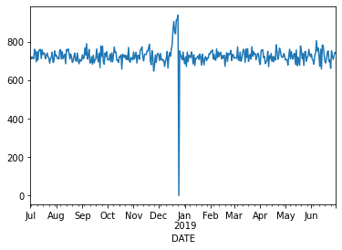
Distribution of sales.
There is a massive spike in sales in the month of December, before it plummets to 0. Further
investigation reveals this to be Christmas day and the store is closed.

Slide 6

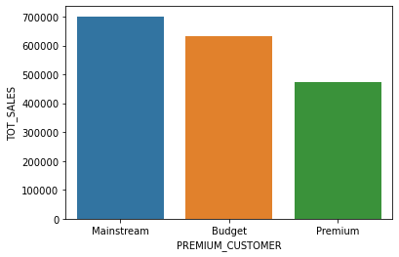
Affluence and its effect on consumer buying for the category of chips
Majority of our customers belong to the mainstream and budget affluence groups.

Slide 7
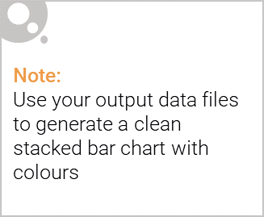
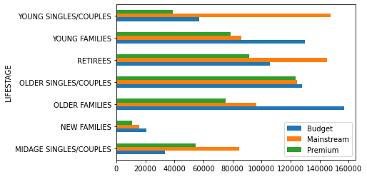
Editable (delete this)
Proportion of customers by affluence and life stage.
Mainstream young singles/couples and retirees along with budget young and older families are the major contributors to our sales.

Slide 8
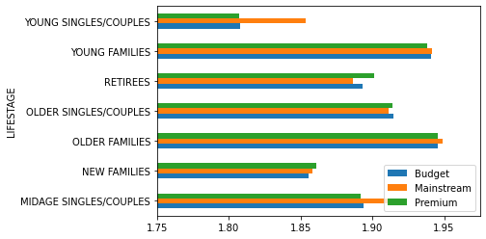
Average product quantity by affluence and life stage.
Customers that have families or are retirees are more likely to purchase two packets on average across all affluence levels compared to their counterparts.

Slide 9
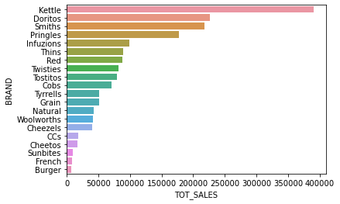
Total sales by brand.
Kettle is the most popular brand by a large margin. Doritos, Smiths and Pringles are close in sales.

Slide 10
02
Trial store performance

Slide 11
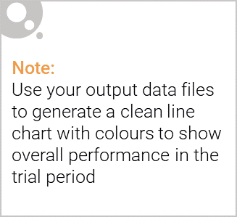
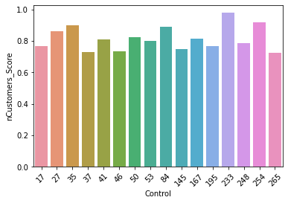
Number of customers score for trial store 77 vs top 15 stores.
Store 233 has the highest score to trial store 77 in regards to the number of customers.

Slide 12
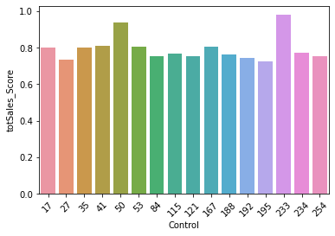
Total sales score for trial store 77 vs top 15 stores.
Store 233 has the highest score to trial store 77 in regards to the total sales.

Slide 13
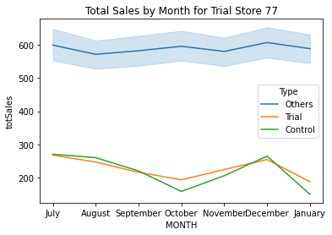
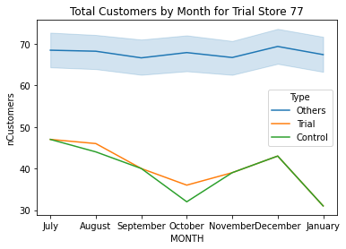
Trial store 77 vs Control Store 233.
Store 233 is very similar to store 77 in both metrics.

Slide 14
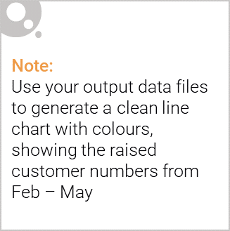
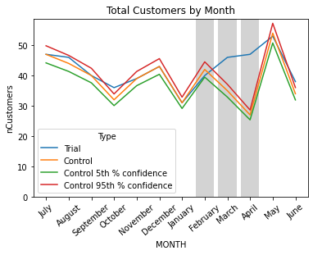
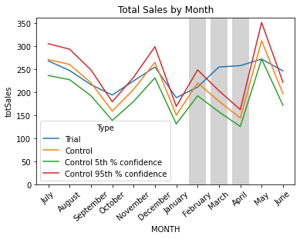
Call out of the performance in the trial store, determining if it was successful
The visualisations suggest that there was an increase in the number of customers, and total sales during the trial period.

Slide 15
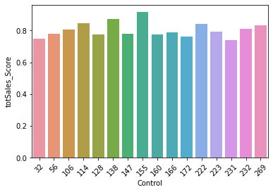
Total sales score for trial store 86 vs top 15 stores.
Store 155 has the highest score to trial store 86 in regards to the total sales.

Slide 16
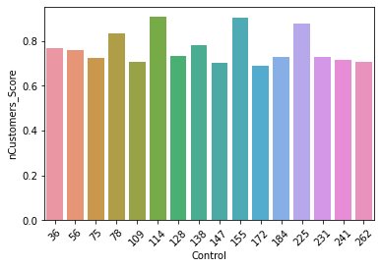
Number of customers score for trial store 86 vs top 15 stores.
Although stores 114 and 155 are very close in score for the number of customers, I suggest using store 155 as the control
store as it has a higher score for total sales than store 114.

Slide 17
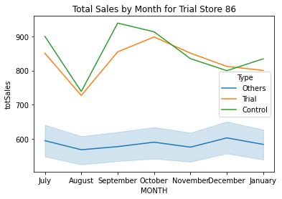
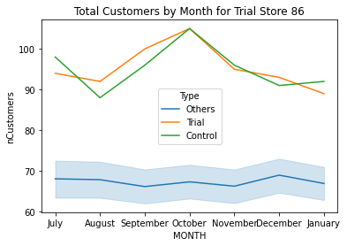
Trial store 86 vs Control Store 155.
Store 155 is very similar to store 86 in both metrics.

Slide 18
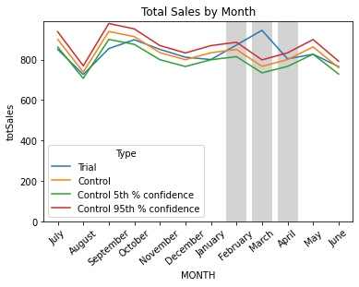
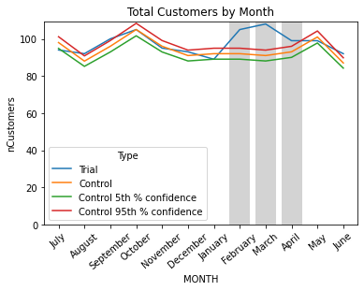
Call out of the performance in the trial store, determining if it was successful
The visualisations suggest that there was an increase in the number of customers, and total sales during the trial period.

Slide 19
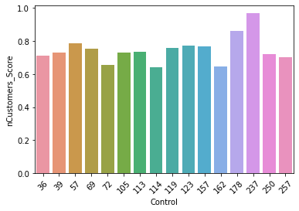
Total sales score for trial store 88 vs top 15 stores.
Store 237 has the highest score to trial store 88 in regards to the number of customers.

Slide 20
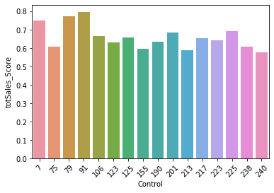
Number of customers score for trial store 88 vs top 15 stores.
It appears that store 237 is not in the top 15 stores for total sales score. It would be prudent to ask
the manager of the store as to how the trial was carried out.

Slide 21
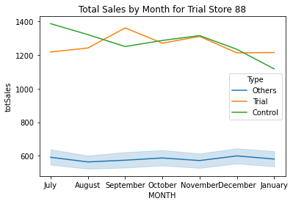
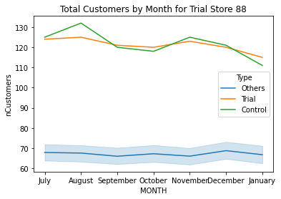
Trial store 88 vs Control Store 237.
Store 237 is very similar to store 88 in both aspects.

Slide 22
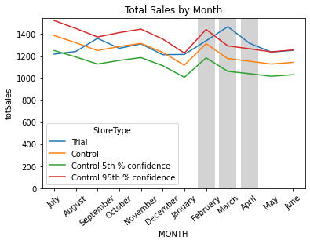
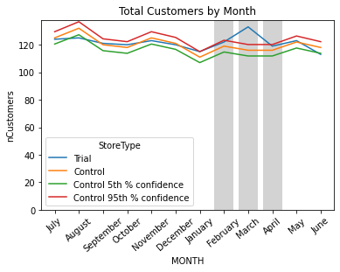
Call out of the performance in the trial store, determining if it was successful
The visualisations show that there was not an increase in the total sales during the trial period even though there was an increase
in the number of customers. It would be prudent to investigate how the trial was carried out in this particular store. A theory is that
there may have been an ongoing promotion which reduced the overall revenue during the trial period.

Slide 23
Conclusion
The control stores for the three trial stores, 77, 86 and 88 are 233, 155 and 237 respectively.
Further investigation suggests that the trial went well for stores 77 and 86, increasing the overall number of customers for each month and subsequently, the total sales.
However, this was not the case for store 88. There was a significant increase in customers but not in the total sales.
One theory is that there may have been an ongoing promotion that may have reduced revenue.
Recommendations
Since there is a huge influx of sales in December, a suggestion would be to ensure that the most popular brands of chips be restocked prior to this.
Brands include Kettles, Doritos, Smiths and Pringles.
Place these packets in areas with the most visibility to enable the impulsiveness of mainstream young singles/couples.
Along with mainstream young singles/couples, target retirees and older families as they are a large contributor to our sales as well.
They tend to buy more than two packets at a time.

